Slide 1


ROS Workshop
-Lecture 2-
Python - Raspberry Pi - Robot Operating System
Husnu Melih Erdogan
Lab Assistant
Intelligent Robotics Lab

Slide 2

Course Structure
Lecture 4 - (Spring - Week 4)
ROS Services and Messages
Writing a Service and Client
ROS .bag file
Lab Assignment 4
Lecture 5 - (Spring - Week 5)
URDF
TF
Getting started with Turtlebot
Lab Assignment 5
Lecture 6 - (Spring - Week 6)
MoveIt
Creating Vikingbot URDF
Robot_State_Publisher
Joint_State_Publisher
Lab Assignment 6
Lecture 7 - (Spring - Week 7)
Gazebo
Creating a Simple Vikingbot Simulation
Lab Assignment 7
Spring Week 8 - 9 - 10
Turtlebot - Vikingbot Project
Lecture 1 – (Spring - Week 1 )
What is ROS?
Introduction to ROS
ROS architecture, philosophy, history
How to install ROS?
Python basics
Examples
Lab Assignment 1
Lecture 2 – (Spring - Week 2)
Linux Basics
ROS commands
Getting familiar with the ROS filesystem
How to create a ROS package?
How to build a ROS package?
How to install released ROS packages?
How to build packages from source?
Lab Assignment 2 – Turtlebot Project
Lecture 3 - (Spring - Week 3)
ROS Nodes Detail
ROS Topics Detail
Writing a Publisher and Subscriber
Lab Assignment 3

Slide 3
Linux Cheat Sheet

Slide 4

Linux – Useful Linux Commands
passwd : change password
ls : Lists the content of the current directory
cd : Changes the current directory to the one specified
pwd: Displays the name of the current working directory
mkdir: Makes a new directory
rmdir: Remove empty directories
nano:
rm: Removes the specified file
cp: Makes a copy of a file and places it at the specified location
mv: Moves a file and places it at the specified location

Slide 5
Linux – Useful Linux Commands
cmod : Normally used to change the permissions for a file
ssh: Secure shell. Connect to another computer using an encrypted network connection
sudo: Run a command as a superuser, or another user.
unzip : Extracts the files from a compressed zip file.
Ifconfig : Displays the network configuration details for the interfaces on the current system when run without any arguments
sudo shutdown –h

Slide 6
XML Format
Xml stands for extensible markup language.
<note> <to>Tove</to> <from>Jani</from> <heading>Reminder</heading> <body>Don't forget me this weekend!</body> </note>
The XML above does not DO anything. XML is just information wrapped in tags.

Slide 7
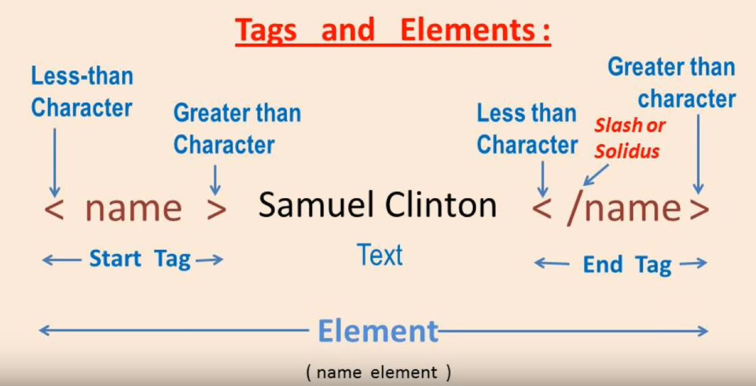
XML Tags and Elements
https://www.youtube.com/watch?v=nyk8QO08grM

Slide 8
Why XML?
It simplifies data sharing
It simplifies data transport
It simplifies platform changes
It simplifies data availability
If you want to learn more about xml:
https://www.w3schools.com/xml/default.asp

Slide 9
Review of Last Week
Rostopic
Rosnode
Messages
Master

Slide 10

ROS Master, Nodes, Topics
ROS Master
Registration
Registration
Registration
Node 1
Publisher
Node 2
Subscriber
Node 3
Subscriber and Publisher
Subscribe
Publish
Publish
Subscribe
Topic
Topic

Slide 11
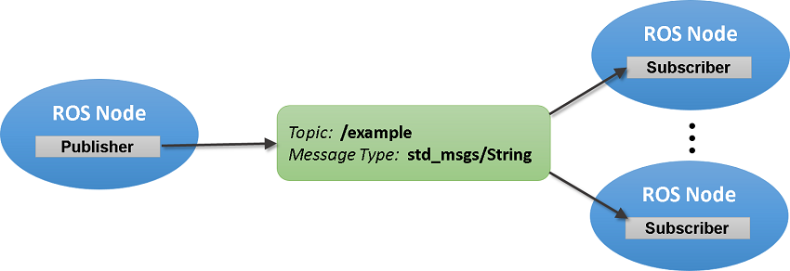

Summary of ROS Messages
Image Source Link

Slide 12
ROS File System
Packages: Packages are the software organization unit of ROS code. Each package can contain libraries, executables, scripts, or other artifacts.
Manifests (package.xml): A manifest is a description of a package. It serves to define dependencies between packages and to capture meta information about the package like version, maintainer, license, etc...

Slide 13
rospack
rospack : gives you information about the package
rospack find package_name
ex: rospack find roscpp

Slide 14
roscd
It is used to change directory to a package or a stack.
roscd package_name
You can also use roscd to move into sub directories.
roscd package_name/sub_directory

Slide 15
rosls
It is used to list to directories inside a package.
rosls roscpp_tutorials
Cmake launch package.xml srv

Slide 16
rosdep
It is used to install system dependencies.
rosdep install my_package
rosdep install --from-paths src --ignore-src --rosdistro indigo

Slide 17
How to Install ROS Packages?
There are two ways to do it.
If there is a Debian package it is easy to install.
If there is no deb package, you have to install it from by sources.

Slide 18

ROS Package Review
Software in ROS is organized in packages.
A package can contain your ROS nodes, any libraries, a dataset, configuration files, message types, scripts, service types, some third-party software.
When you want to create a project in ROS, first you need to create a package
ROS package are usally for certain ROS distributions
Packages have dependencies
http://www.ros.org/browse/list.php?package_type=package&distro=indigo

Slide 19
Method 1
apt-get install ros-<ros-distribution>-<package-name>
Example:
http://www.ros.org/browse/list.php
apt-get install ros-indigo-effort-controllers

Slide 20
Method 2
- cd catkin_ws/src
- https://github.com/ros/ros_tutorials
- git clone -b indigo-devel https://github.com/ros/ros_tutorials.git
- cd catkin_ws
- rosdep install --from-paths src --ignore-src --rosdistro indigo
- catkin_make

Slide 21
Server Login
Windows:
run Putty
Other:
ssh yourname@ros-server.ece.pdx.edu
Password: SpringROS12345

Slide 22
Example 1
Topic: chatter
Msg: String
Topic: chatter
Msg: String
talker.py
listener.py

Slide 23
Example 1
Student 1 : rosrun rospy_tutorials listener.py
Student 2 : rosrun rospy_tutorials talker.py

Slide 24
Example 2
Topic: chatter1
Msg: String
Topic: chatter1
Msg: String
Topic: chatter2
Msg: String
Topic: chatter2
Msg: String
talker.py
listener.py
talker.py
listener.py
Student 1
Student 2
Student 3
Student 4
Topic: chatter3
Msg: String
Topic: chatter3
Msg: String
talker.py
listener.py
Student 5
Student 6

Slide 25
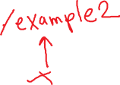
Remapping Arguments
Any ROS name within a node can be remapped when it is launched at the command-line.
http://wiki.ros.org/Remapping%20Arguments

Slide 26
Example 2
Student 1 : rosrun rospy_tutorials listener.py /chatter:=/chatter1
Student 2 : rosrun rospy_tutorials talker.py /chatter:=/chatter1
Student 3 : rosrun rospy_tutorials listener.py /chatter:=/chatter2
Student 4 : rosrun rospy_tutorials talker.py /chatter:=/chatter2
Student 5 : rosrun rospy_tutorials listener.py /chatter:=/chatter3
Student 6 : rosrun rospy_tutorials talker.py /chatter:=/chatter3

Slide 27
How to Create a ROS Package?
For a package to be considered a catkin package it must meet a few requirements:
The package must contain a catkin compliant package.xml file.
That package.xml file provides meta information about the package.
The package must contain a CMakeLists.txt which uses catkin. If it is a catkin metapackage it must have the relevant boilerplate CMakeLists.txt file.
There can be no more than one package in each folder.
This means no nested packages nor multiple packages sharing the same directory.

Slide 28
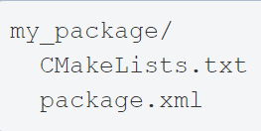
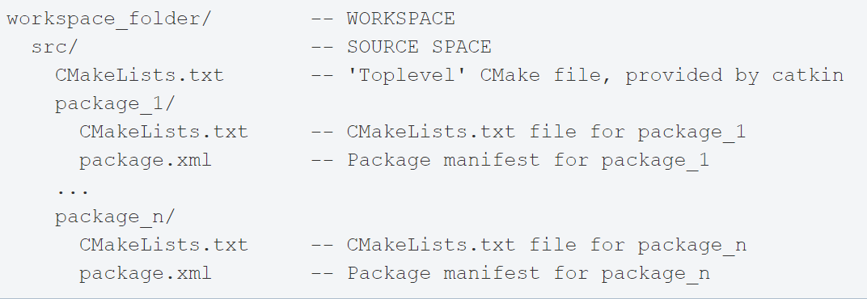
ROS Package
Way 1:
Way 2:

Slide 29
How to Create a ROS Package?
Create your workspace
Go to your source directory
cd ~/catkin_ws/src
Create a new package
catkin_create_pkg <package_name> [depend1] [depend2] [depend3]
Build the workspace and source the setup.bash file
cd ~/catkin_ws
. ~/catkin_ws/devel/setup.bash

Slide 30
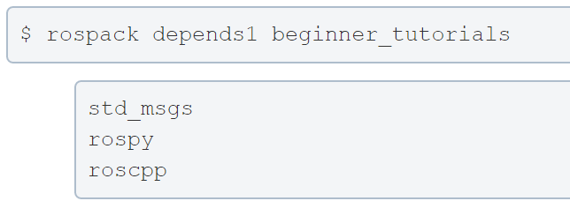
Rospack Dependencies
catkin_create_pkg beginner_tutorials std_msgs rospy roscpp

Slide 31
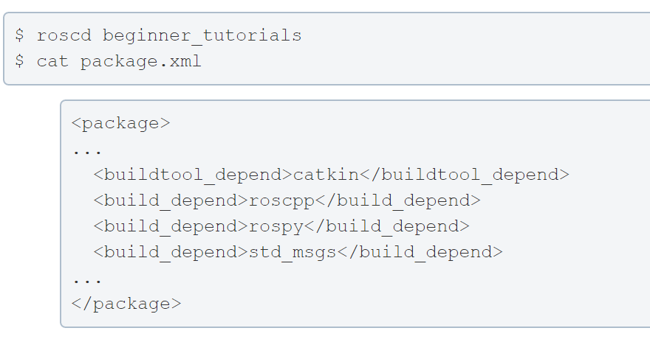
Rospack Dependencies
These dependencies for a package are stored in the package.xml file:

Slide 32
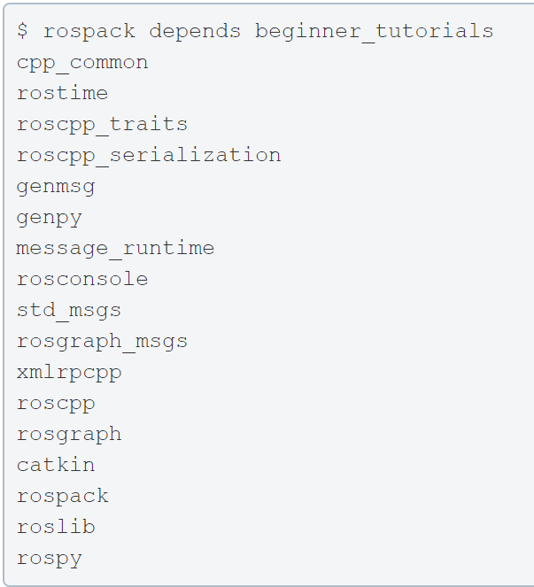
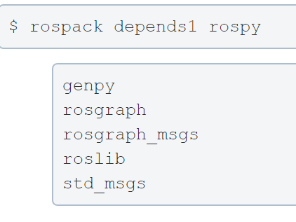





Indrect Dependencies
A dependency can also have its own dependencies.
All indirect dependencies

Slide 33
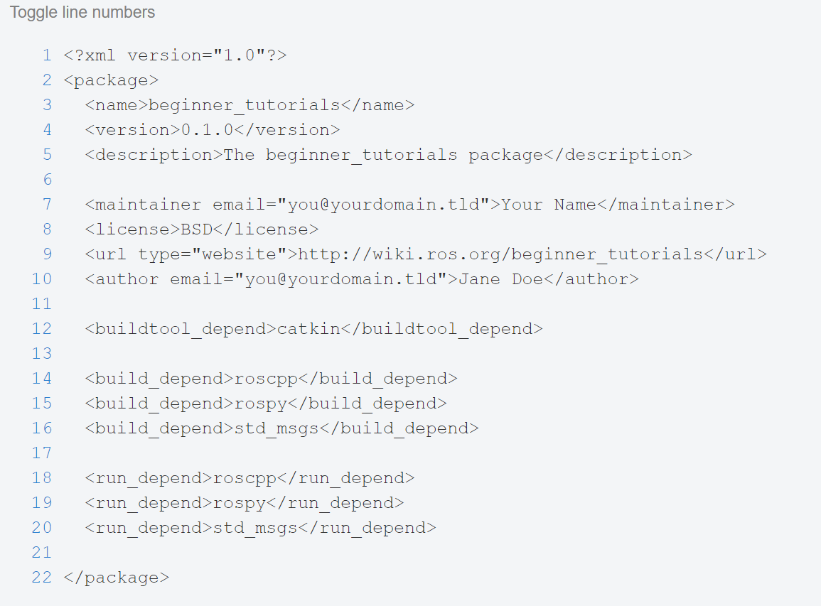
Customize your ROS Package
The generated package.xml should be in your new package.

Slide 34
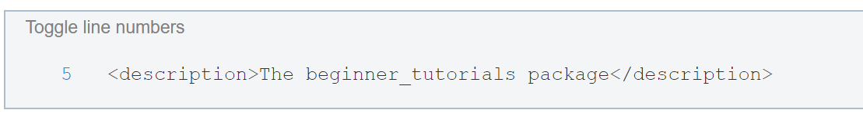
Customize your ROS Package
Description Tag:
Describe your package in a few words

Slide 35
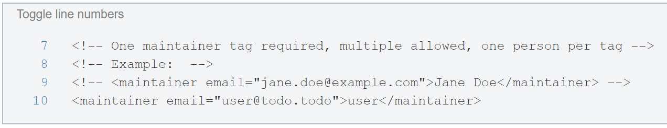
Customize your ROS Package
Maintainer Tags:
This is a required and important tag for the package.xml
Let others know who to contact about the package.

Slide 36
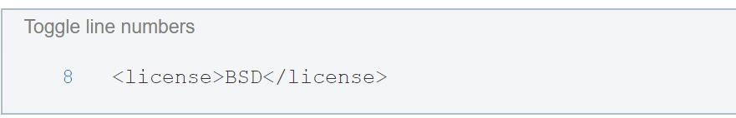
Customize your ROS Package
License Tags:
You should choose a license and fill it in here. Some common open source licenses are BSD, MIT, Boost Software License, GPLv2, GPLv3, LGPLv2.1, and LGPLv3

Slide 37
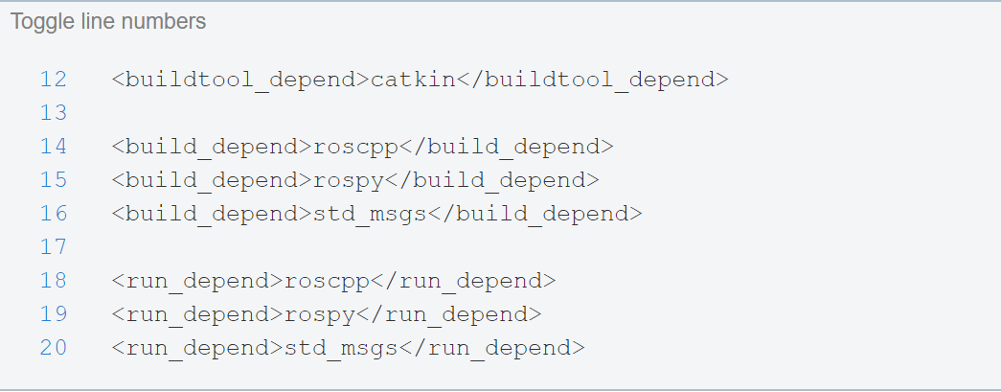
Customize your ROS Package
Dependencies Tags:
We define all of our specified dependencies to be available at build and run time.

Slide 38




ROS Package Review

Slide 39
TURTLEBOT 2i PROJECT

Slide 40





















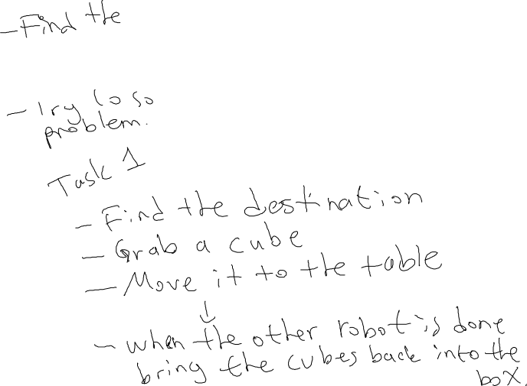

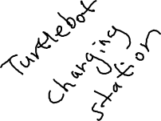
Project

Slide 41
Turtlebot Project
Please check your emails.
Go to the website, watch the videos.
Create a 2D map of the lab.
Team 1 use turtlebot 1,
Team 2 use turtlebot 2.
We will pick the best one and use it in this projects.

Slide 42
Lab Assignment 2
Create a package in your work space:
Name the package <yourname>_myf_irst_package
Dependencies: std_msgs, rospy, roscpp
Customize your package.

